Slide 1
PostgreSQL

Slide 2

INTRODUCTION : PostgreSQL
It is an powerful, open source object-relational database system with over 30 years of active development.
It has a strong reputation for
Reliability
Feature robustness
Performance
Some of the notable features:
Streaming Replication
Multiversion concurrency control
Flexible API -Python, Perl , PHP , C, C++
Procedural Languages

Slide 3
How to download and install PostgreSQL:
Step 1 :Go to https://www.postgresql.org/download and select your preferred operating system
Step 2: Open the installer .exe file to start installing
Step 3: Select your preferred language
Step 4: Locate the path to install the PostgreSQL software on your system
Step 5: Select the components you want to install
Step 6: Set the superuser password and make a note of it
Step 7: Give the port number as the default
Step 8: Click the Next button to start the installation
Note :
Installation Link : https://www.tutorialspoint.com/postgresql/postgresql_environment.htm

Slide 4
How to start using PostgreSQL:
Step 1: Go to Start Menu and search pgAdmin 4
Step 2: The pgAdmin homepage will open
Step 3: Click on Servers > PostgreSQL 10 in the left tree
Step 4: Enter superuser password set during installation and click the OK button
Step 5: The PostgreSQL dashboard will open

Slide 5
Uses of PostgreSQL
Financial Industry:PostgreSQL is an ideal DBMS system for the financial industry.
Government GIS data:PostgreSQL offers powerful GIS, called “PostGIS” which provides hundreds of functions to process geometric data in different formats.
Manufacturing:PostgreSQL is also used in industrial manufacturing to speed up the overall business process.
Web technology and NoSQL:PostgreSQL works fine with all modern web frameworks like Django, Node.js, Hibernate, PHP, etc. It offers replication capabilities to scale out many database servers.
Scientific data:PostgreSQL offers wonderful analytical capabilities and a powerful SQL engine. This helps you to manage a large amount of data with ease.

Slide 6
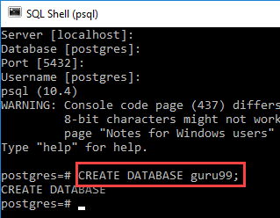
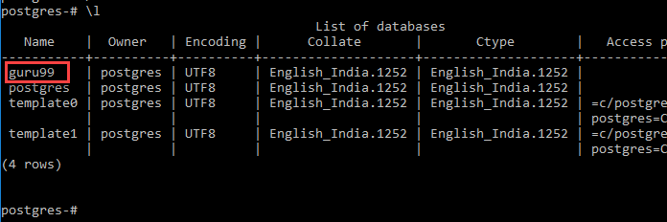
PostgreSQL to Create Database:
Create database in PostgreSQL is
CREATE DATABASE databasename
PSQL Create Database Command Line
Open the SQL Shell
Press enter five times to connect to the DB
Enter the command
Enter command \l to get a list of all databases
To connect to a Database use PostgreSQL command : \c

Slide 7
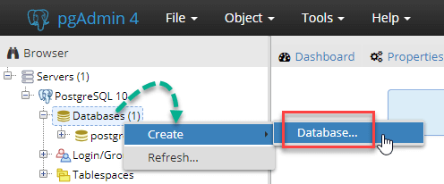
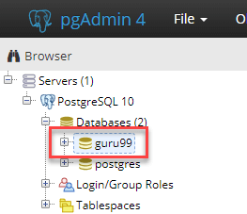
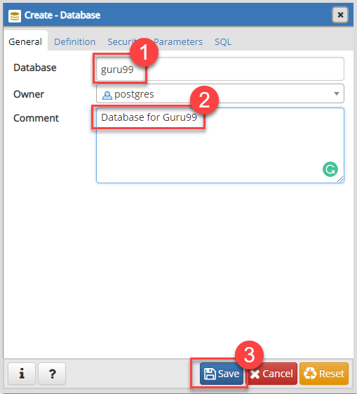
PostgreSQL Create Database using pgAdmin
Step 1 : In the Object Tree, right click and select create a database to Postgres create database
Step 2: In the pop-up,
Enter Database Name
Comment if any database – optional
Click Save
Step 3:DB is created and shown in the Object tree.
Step 4:The right pane gives you the SQL used to create the Database.

Slide 8
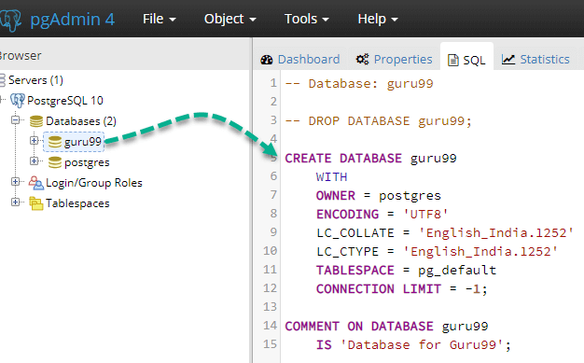
Complete Syntax to create a DB in PostgreSQL:
CREATE DATABASE db_name
OWNER = role_name
TEMPLATE = template
ENCODING = encoding
LC_COLLATE = collate
LC_CTYPE = ctype
TABLESPACE = tablespace_name
CONNECTION LIMIT = max_concurrent_connection

Slide 9
PostgreSQL Queries :
SELECT Queries : used to fetch the data from a database table, which returns data in the form of result table.
SELECT column1, column2, columnN FROM table_name;
Example : SELECT * FROM table_name;
INSERT Queries : allows one to insert new rows into a table
INSERT INTO TABLE_NAME (column1, column2,...columnN) VALUES (value1, value2,...valueN);
Example : INSERT INTO COMPANY (ID,NAME,AGE,ADDRESS,JOIN_DATE) VALUES (2, 'Allen', 25, 'Texas', '2007-12-13');
DELETE Queries : used to delete the existing records from a table
DELETE FROM table_name WHERE [condition];
EXAMPLE : DELETE FROM COMPANY WHERE ID = 2;

Slide 10
UPDATE Clause: used to modify the existing records in a table
UPDATE table_name SET column1 = value1, column2 = value2...., columnN = valueN WHERE [condition];
EXAMPLE : UPDATE COMPANY SET SALARY = 15000 WHERE ID = 3;
LIMIT Clause: used to limit the data amount returned by the SELECT statement
SELECT column1, column2, columnN FROM table_name LIMIT [no of rows]
SELECT column1, column2, columnN FROM table_name LIMIT [no of rows] OFFSET [which it leaves certain rows from top ]
EXAMPLE : SELECT * FROM COMPANY LIMIT 4;
SELECT * FROM COMPANY LIMIT 3 OFFSET 2; \\ WITH OFFSET , does not take first 2 rows from company
WHERE Clause : used to specify a condition while fetching the data from single table or joining with multiple tables.
SELECT column1, column2, columnN FROM table_name WHERE [search_condition]
EXAMPLE : SELECT * FROM COMPANY WHERE AGE >= 25 AND SALARY >= 65000;

Slide 11
ORDER BY Clause: used to sort the data in ascending or descending order, based on one or more columns.
SELECT column-list FROM table_name [WHERE condition] [ORDER BY column1, column2, .. columnN] [ASC | DESC];
EXAMPLE : SELECT * FROM COMPANY ORDER BY AGE ASC;
AND Clause: complete condition will be assumed true when all the conditions are true
SELECT column1, column2, columnN FROM table_name WHERE [condition1] AND [condition2]...AND [conditionN];
EXAMPLE : SELECT * FROM COMPANY WHERE AGE >= 25 AND SALARY >= 65000;
OR Clause: complete condition will be assumed true when at least any of the conditions is true.
SELECT column1, column2, columnN FROM table_name WHERE [condition1] OR [condition2]...OR [conditionN];
EXAMPLE : SELECT * FROM COMPANY WHERE AGE >= 25 OR SALARY >= 65000;

Slide 12
ALTER table: command is used to add, delete or modify columns in an existing table
ALTER TABLE table_name ADD column_name datatype;
\\ ADD OR DROP OR CHANGE DATA TYPE OR CHANGE NOT NULL
EXAMPLE :ALTER TABLE COMPANY ADD GENDER char(1);
TRUNCATE table: command is used to delete complete data from an existing table
TRUNCATE TABLE table_name;
EXAMPLE: TRUNCATE TABLE COMPANY;
DROP table: statement is used to remove a table definition
DROP TABLE table_name;
EXAMPLE : drop table department, company;

Slide 13
ALIAS Syntax: One can rename a table or a column temporarily by giving another name
SELECT column1, column2..FROM table_name AS alias_name WHERE [condition];
EXAMPLE : SELECT C.ID, C.NAME, C.AGE, D.DEPT FROM COMPANY AS C, DEPARTMENT AS D WHERE C.ID = D.EMP_ID;
BETWEEN Clause: match a value against a range of values.
value BETWEEN low AND high; or value >= low and value <= high or value NOT BETWEEN low AND high;
EXAMPLE : SELECT amount FROM payment WHERE amount BETWEEN 8 AND 9;
SELECT DISTINCT Keyword: eliminate all the duplicate records and fetching only unique records
SELECT DISTINCT column1, column2,.....columnN FROM table_name WHERE [condition]
EXAMPLE : SELECT DISTINCT name FROM COMPANY;

Slide 14
IN Operator: used with the WHERE clause to check against a list of values
value IN (value1, value2, …) or value IN (SELECT value FROM tbl_name);
EXAMPLE : SELECT * FROM Employees WHERE name IN ('James John', 'Mercy Bush', 'Kate Joel');
LIKE Operator : helps us to match text values against patterns using wildcards. Two wildcards Percent sign (%) and Underscore (_)
expression LIKE pattern [ ESCAPE 'escape-character' ]
EXAMPLE : SELECT * FROM Book WHERE name LIKE 'Lear%';
SELECT *FROM Book WHERE name LIKE '_earn%';
INSERT INTO SELECT: If one wish to insert into a separate table from already existing values within one table (or across several other tables) than this command is used.
INSERT INTO table_name [ ( column_name [, ...] ) ] query
EXAMPLE : INSERT INTO books (id,author_id) SELECT nextval('book_ids'),author_id FROM book_queue WHERE approved;

Slide 15
In Conclusion:
PostgreSQL may not be as popular as MySQL
The PostgreSQL documentation is excellent and available online as HTML or offline as PDF
psql is good to use in scripts
The best way to learn SQL is to play with it.

